Slide 1


VIRTUAL
BRICS TRADE FAIR 2021
16-18 August 2021

Slide 2

BRICS TRADE FAIR 2021:
KEY ELEMENTS
Exhibition (Virtual) to have country pavilions from BRICS nations including BRICS Women Entrepreneurs pavilion
Business to Business Match-making
BRICS Investment Lounge (Virtual)
Buyer – Seller meets – Interactive B2B Portal
BRICS Business Forum (Virtual)

Slide 3

BRICS TRADE FAIR 2021:
FOCUS AREAS
Private and public sector participation. Leading companies to showcase goods, services and technologies at the BRICS Trade Fair. A multi-product show with nearly 20 focus sectors.
Showcasing technologies. The Trade Fair will also bring together technology solutions providers that address some of the key development challenges such as sanitation, energy efficiency, healthcare delivery, education delivery, water management etc.
State and provinces participation. State / provincial governments from BRICS countries will also showcase their strengths and investment projects available.

Slide 4
BRICS TRADE FAIR 2021:
FOCUS SECTORS
Aerospace | Gems & Jewellery | Machine tools
Agriculture and Agro processing | Green Energy | Mining and Metalogical industries
Auto components | Handicrafts | Science and Technology
Chemicals | Healthcare & Pharma | Skills Development
Creative Industries | High Technology | Start ups
Digital Economy | Home textile and Furnishing | Textiles, Apparel and Sportswear
Electric mobility | Information and communication Technology | Water and Sanitation
Electronics | Infrastructure including Urban Infra
Financial Services | Leather and Footwear

Slide 5

BRICS INVESTORS LOUNGE
Investor facilitation lounge with exclusive pavilion for Investment Promotion Agencies of BRICS countries
Investment Promotion agencies will cater to:
Investors’ queries
Advice them on the investment opportunities in their respective country
Advice them on the rules and regulations in their country with respect to the investors’ preference of sectors
May act as a one-point contact for investors for facilitating their investment in their country

Slide 6

BRICS TRADE FAIR 2021:
KEY TAKEAWAYS
Meet and network with CEOs from top companies
Meet
Have one to one business meetings with the decision makers
Interact with Investment Promotion Agencies and Export Promotion Agencies
Witness
Witness leading technologies on offer from innovator companies
Discuss
Discuss about financing frameworks and trade instruments available from the Export Import Banks and Export Credit Agencies
Participate
Participate in BRICS Business Forum
Network
Interact

Slide 7
BRICS Women Entrepreneurs Expo 2021
Co-located with BRICS Trade Fair, BRICS WBA will organize a thematic virtual pavilion of BRICS Women Entrepreneurs
Leading women led business houses from the BRICS nations will showcase their products & services at the expo

Slide 8

BRICS TRADE FAIR 2021:
VIRTUAL PLATFORM

Slide 9
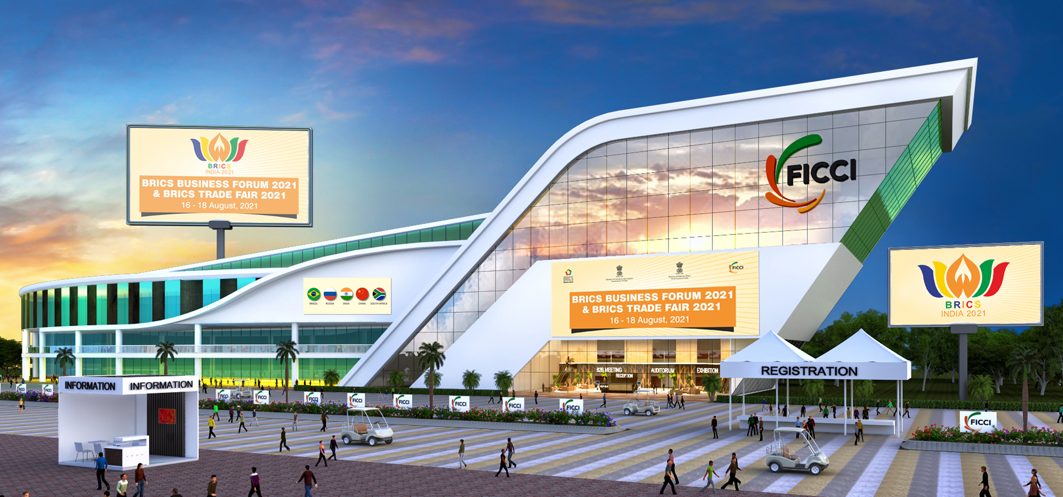
BRICS VIRTUAL CONVENTION CENTRE

Slide 10
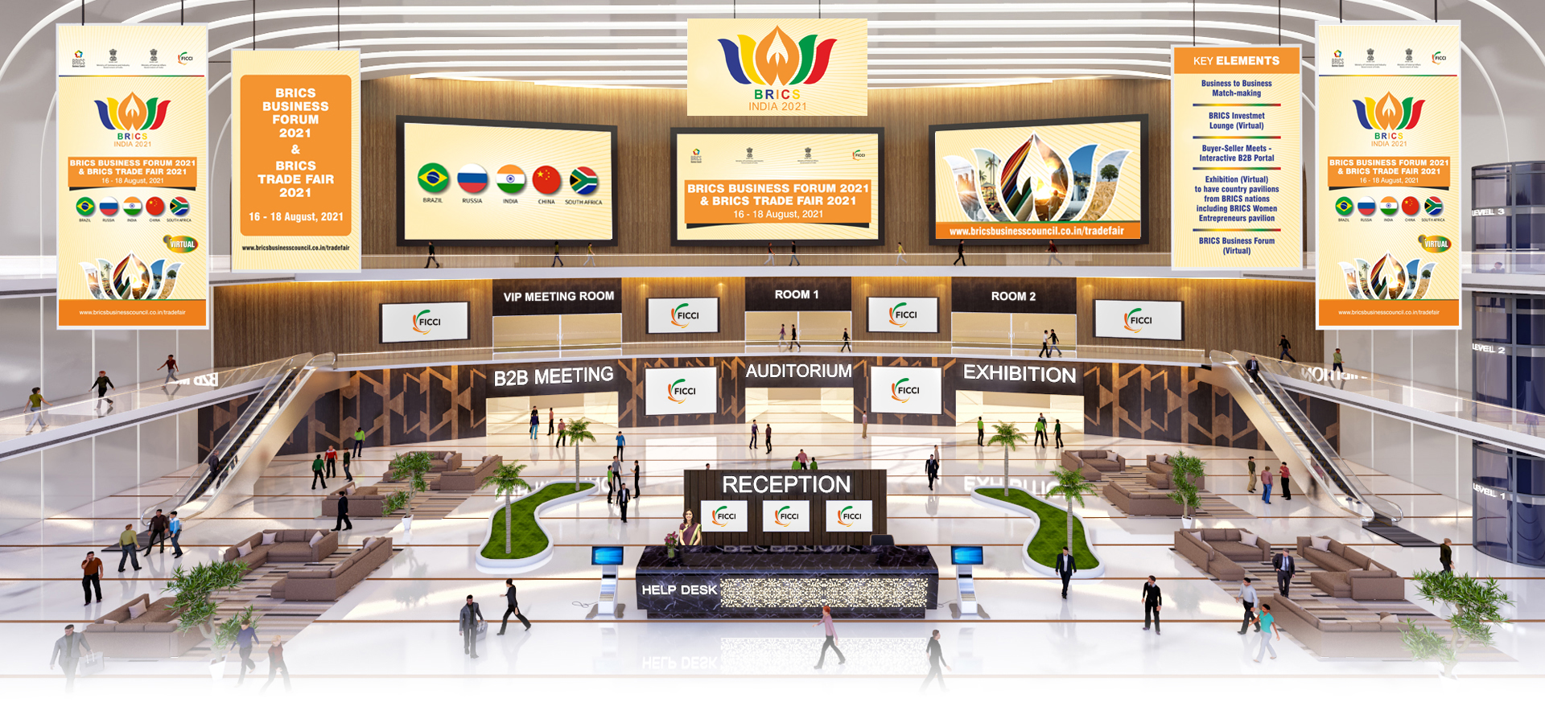
CONVENTION CENTRE LOBBY

Slide 11
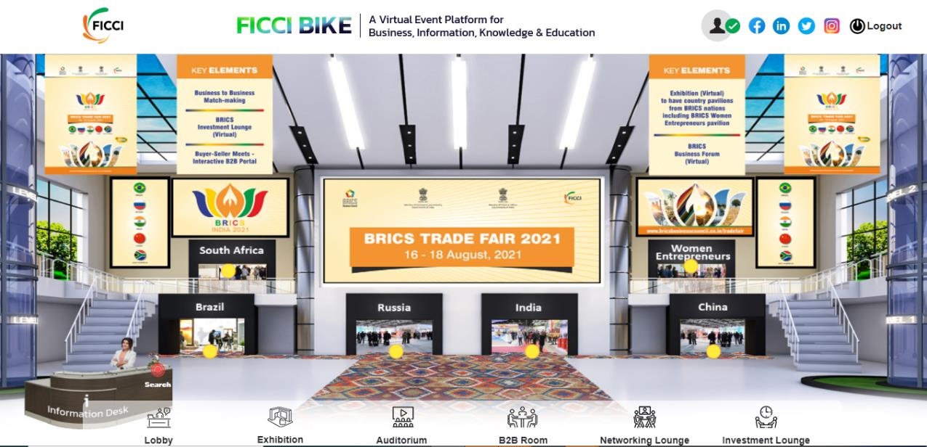
EXHIBITION LOBBY

Slide 12
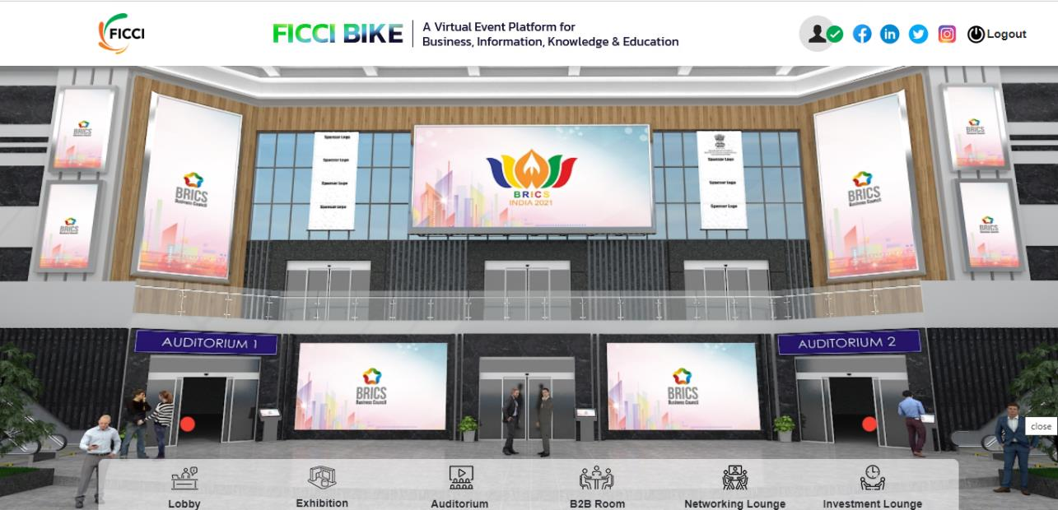
VIRTUAL CONFERENCE AUDITORIUM LOBBY

Slide 13

Virtual Conference Hall

Slide 14
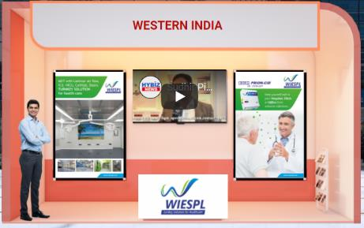

Sample Virtual Booths
Option to upload two posters from Exhibitors Dashboard
Upload Company Logo on Front desk from Exhibitors Dashboard
Display upto 10 Product Brochures in your stand
Integrate your website & social media links to your booth
Live interaction over text, audio or video chat
Exhibitors staff can login from 5 separate systems(Laptop/Desktop) and can do simultaneous interactions
Exchange E-Business Cards & many more features

Slide 15
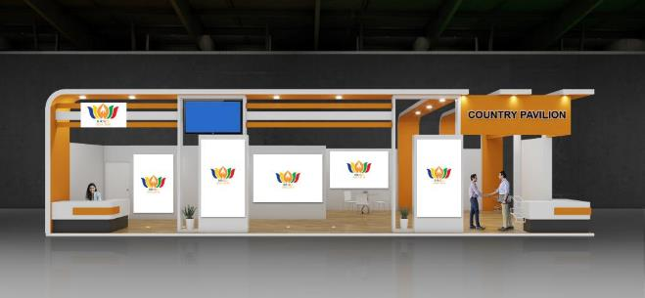
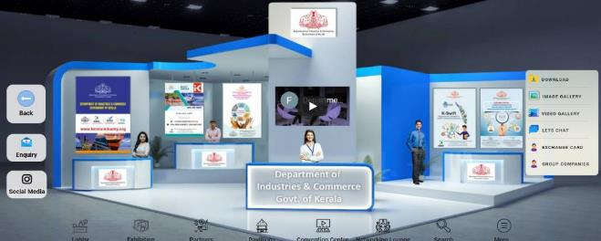
Virtual Investment Lounge/State/Province Pavilion

Slide 16
BRICS Trade Fair 2021: Point of Contacts
S.No | Country | PoC- Virtual Trade Fair | Email | Mobile No
1 | Brazil | Kunal Chaudhary | kunal.chaudhary@ficci.com | 9650282444
2 | Russia | Pallavi Thakur | pallavi.thakur@ficci.com | 9953038483
3 | India | Yash Ashish | yash.ashish@ficci.com | 9971469227
4 | China | Mehul Tyagi | mehul.tyagi@ficci.com | 9999829252
5 | South Africa | Vivek Mishra | vivek.mishra@ficci.com | 9015830574

Slide 17
Thank You

